Slide 1
NEWBIE’S KEY
Sri Harsha Kumar Raja Golla(15)
Sita Ratna Deepika Lalam(24)
Avinash Penti(42)
Alekhya Polavarapu(43)

Slide 2
Project Overview
User can search for apartment vacancies at a particular location or around his current location.
User Can negotiate the price with the owner through call or through chat.

Slide 3
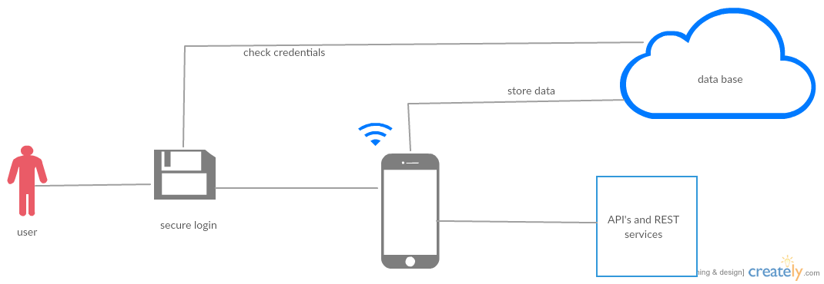
Architecture Diagram

Slide 4





Technologies Used

Slide 5
Application Features
User can login using his credentials or Register as a new user.
Social Login Using the Facebook OAuth
Search for Apartments using 2 options
a) Around User’s current location
b) At a particular location user is interested in.
Autofill Google API integrated in the search bar
Results can be viewed in 2 ways
a) Map View with Markers
b) List View
User can contact the owner using the call an chat facilities and make an agreement
Provided Slider Interface so user can navigate between screens easily.

